Slide 1
Shop123 Test Machine
Samuele Zaza, IT product manager, Nov. 2015

Slide 2
Test Machine
Currently version 1.1.5.
Built with Vagrant: https://www.vagrantup.com/.
Warning: The ppt will not cover the details of Vagrant but it meant to help the team to rapidly set it up and use it. For more details check the “References” page.

Slide 3
Test Machine
Benefits of Vagrant:
Easy to setup.
no “works on my machine” excuse.
Synch folder between host and guest OS.
A local machine is a good practice for an Agile developer.

Slide 4
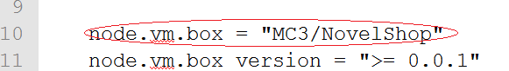
Test Machine
Installation
Install git, vagrant, virtualbox.
Clone the project from my github https://github.com/samuxyz/NovelShop .
Open the “Vagrantfile”with a text editor and edit line 10.

Slide 5
Test Machine
Run the machine
Open virtualbox.
Open cmd, move the test machine folder and type “vagrant up --provision”.

Slide 6
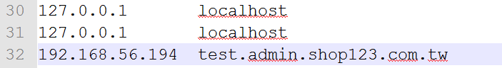
Test Machine
Fix the code to run on the machine:
Change database server ip to localhost.
In “novel.php”add a line “extract($_POST);” because PHP 5.6 does not provide the function to automatically $_POST[“foo”] -> $foo.
Edit “hosts”file in Windows:
Go to C:\Windows\System32\drivers\etc and open with administrator privilegies the file hosts.
Add a line like the following

Slide 7
Test machine
Vagrant has built-in support forautomated provisioning.
On vagrant up we may add scripts that will install or modify the system before making the machine available.
The test machine comes with only two databases.
So what about adding another db?

Slide 8

Test machine
Add a script in the folder /provision with the command(s) you want to run.
There is already a sample code for adding the DB in setup-dbdata.sh.
Tell Vagrant to run the file by editing Vagrantfile.
(The example tell vagrant to start apache because or it will not sync the log folders).
Run “vagrant up --provision”.
We are forced to use --provision because the first time the machine was run it did not have that script, or it would automatically run it.

Slide 9
References
Vagrant website, https://www.vagrantup.com/.
Vagrant documentation, https://docs.vagrantup.com/v2/.
Public box at https://atlas.hashicorp.com/samuxyz/boxes/novelShop.
An easy guide to create a vagrant box, https://atlas.hashicorp.com/samuxyz/boxes/novelShop

